Slide 1
Predicting Probability of Credit Card Default
Jennifer Rodriguez-Trujillo
Joseph Schuman
Khevna Parikh
Kristin Mullaney
Rodrigo Kreis de Paula
Sarvesh Patki
05.03.2023

Slide 2






Problem Statement
Predict if customers will default on their credit cards
Overview
Data & Model
Optimization
Results
Background:
Credit default prediction is central to managing risk in a consumer lending business and key for a healthy business environment
A successful model creates a better customer experience for cardholders by making it easier to be approved for a credit card
Effectively analyze extensive & complex data quickly:
Optimized code can quickly process the enormous quantity of credit card data to identify future defaults
Credit Default prevention could save businesses and consumers a substantial amount of money, creating a more efficient business environment
Notes:
Sarvesh

Slide 3
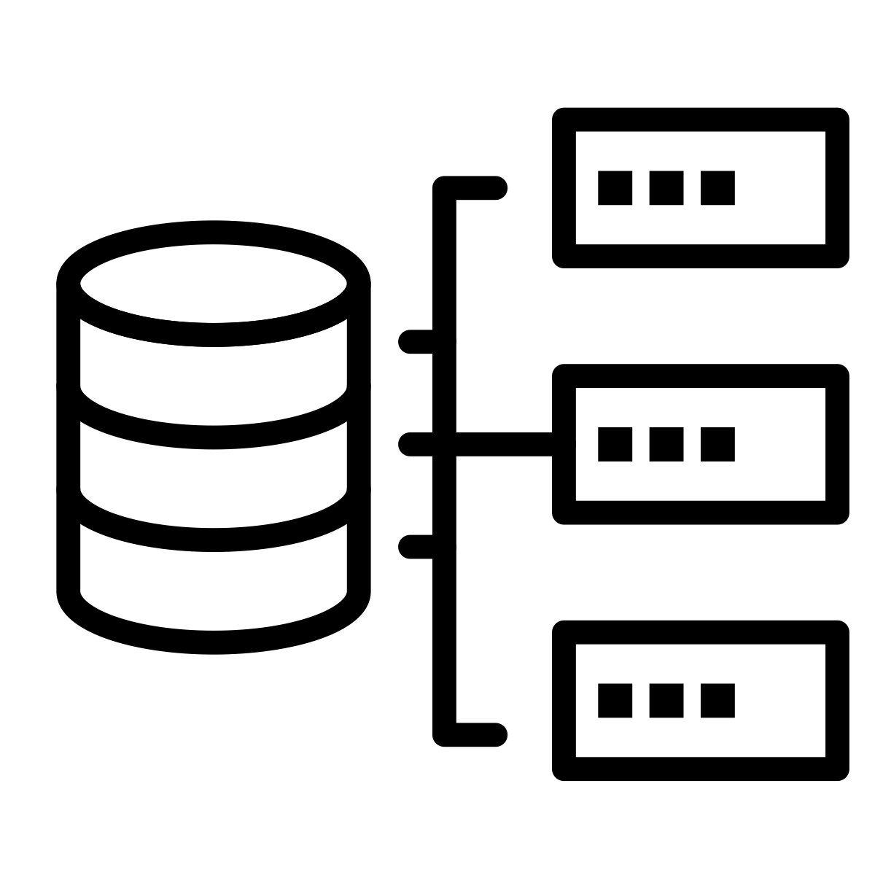

Data & Model Overview:
Overview
Data & Model
Optimization
Results
Source: American Express Default Prediction (Kaggle)
5,531,451 records. Each is a credit card statement
190 variables, which track the customers' profile by observing an 18-month performance window
Binary target variable is Default Status. Default = Y if the customer does not pay the credit card statement in 120 days
Dataset
The objective is to implement a model that predicts the probability of a default
We first implemented a simple yet computationally intensive Logistic Regression Model (baseline)
We then implemented various techniques to improve performance
Model
Notes:
Rodrigo

Slide 4






Optimization Techniques:
We improved the efficiency of our model and code by implementing the following:
Overview
Data & Model
Optimization
Results
Line Profiling
Minimizing repetitive for-loops
Vectorization through NumPy
Python Jax
Parallel Processing
Notes:
Kristin

Slide 5
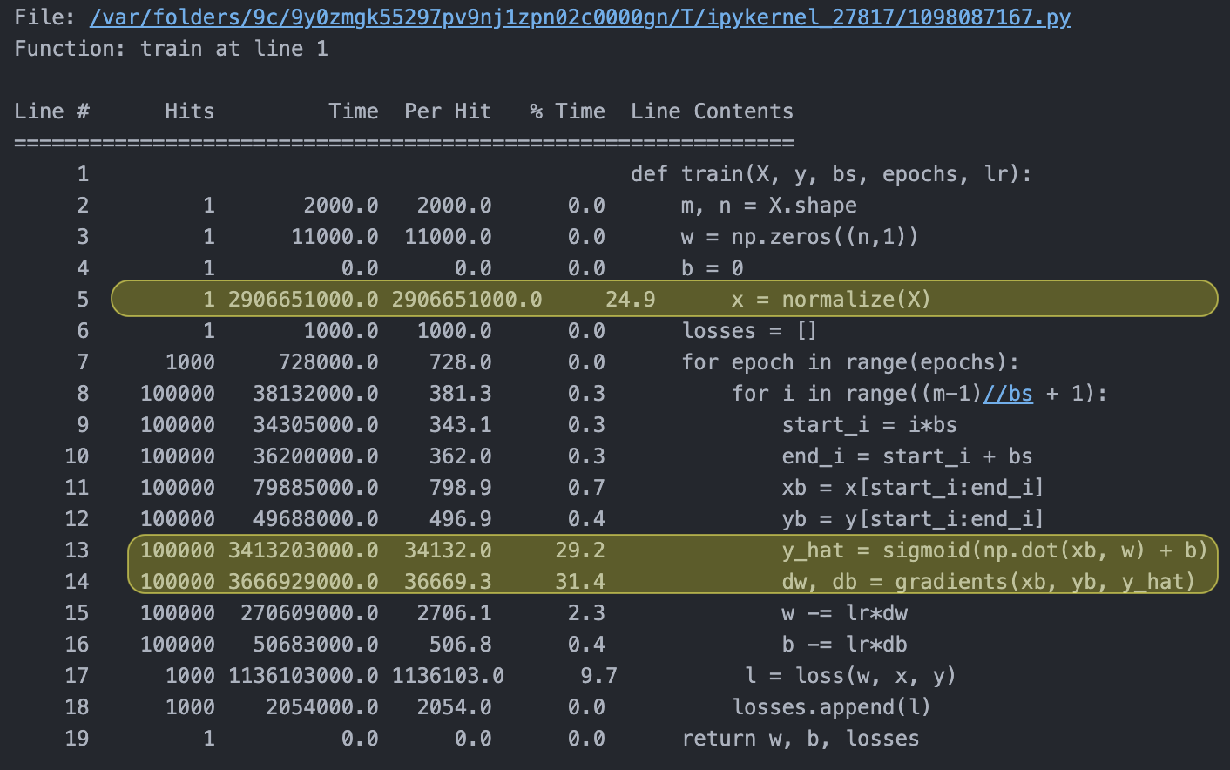
Optimization Techniques:
Parquet files and Line Profiler
Overview
Data & Model
Optimization
Results
Implemented line profiling to identify the time and resources usage of each line of our code
Our training dataset (in CSV) is quite large, at 16.3 GB in size.
As a result, reading in the file takes several minutes.
To speed up the process, we first compressed the dataset into Parquet files, resulting in a smaller size of 3 GB.
The baseline model took 6,368 seconds to run on the entire training dataset, achieving an accuracy of 0.87.
Notes:
Khevna

Slide 6
Optimization Techniques:
Numpy & Vectorization
Overview
Data & Model
Optimization
Results
Through line profiling, discovered that nested for loops were causing the majority of the processing time
Minimized the use of for-loops by vectorizing techniques where possible.
Utilized the NumPy library for performing efficient mathematical operations like np.dot
Simplified our code by taking advantage of other NumPy functions, like np.where
As a result of these optimizations, we were able to reduce our code’s processing time to 3,000 seconds (half the original time!).
Notes:
Jennifer & Joe

Slide 7
Optimization Techniques:
Python Jax
Overview
Data & Model
Optimization
Results
Jax provides the functionality of automatic differentiation.
For example, we used ‘grad’ function to compute the derivative of the loss function automatically
We used Jax composable functions ‘jit’ and ‘vmap’ to vectorize functions where applicable
Jax took 216 seconds to run our code with 100,000 records, whereas NumPy took 164 records.
In conclusion, Jax is better for certain operations like gradient calculations, while NumPy is better for others.
Notes:
Jennifer

Slide 8
Optimization Techniques:
Parallel Processing
Overview
Data & Model
Optimization
Results
MPI (Messaging Passing Interface), a parallel programming implementation, enables communication between processes. With MPI, we were able to coordinate computation via shared data and messaging
We used distributed computing to allocate calculations across multiple nodes and multiple cores
We did not experience efficiency improvements on the subset of 100,000 records
Notes:
Khevna

Slide 9
Results
Overview
Data & Model
Optimization
Results
Full Dataset (5mm records) | Runtime (seconds) | Improvement
Baseline | 10,368 | N/A
NumPy | 3,012 | 3.44x
Subset (100k records) | Runtime (seconds) | Improvement
Baseline | 408.83 | N/A
NumPy | 103.86 | 3.94x
NumPy + Jax | 183.63 | 2.22x
NumPy + MPI | 456.2 | 0.89x
Notes:
Khevna

Slide 10
Thank You

